Slide 1
Literacy Coaching
Colleen graham, stephenie logan,
emily quinn

Slide 2
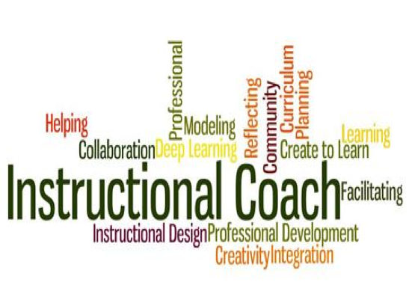

Slide 3
Literacy Coach Mission
“To support and coach teacher as they facilitate, support, model, and assess students with an overarching goal of creating literacy learners who regularly engage in the eight components of balanced literacy.”
Are We on the Same Book and Page?
By Julie E. Wollman

Slide 6
“We know practice grounded in shared theory and vision provides the greatest coherence, and therefore, the greatest potential for transforming schools into
better places for student learning.“
Julie E. Wollman
Are We on the Same Book and Page?
The Value of a Shared Vision and Theory

